Slide 1
Barely Sufficient Project Management A few techniques for improving your scientific software development efforts
HPC Best Practices Webinar Series
Michael A. Heroux Senior Scientist, Sandia National Laboratories Scientist in Residence, St. John’s University, MN

Slide 2
Acknowledgments
This work was supported by the U.S. Department of Energy Office of Science, Office of Advanced Scientific Computing Research (ASCR), and by the Exascale Computing Project (17-SC-20-SC), a collaborative effort of the U.S. Department of Energy Office of Science and the National Nuclear Security Administration.
Sandia National Laboratories is a multimission laboratory managed and operated by National Technology and Engineering Solutions of Sandia, LLC, a wholly owned subsidiary of Honeywell International, Inc., for the U.S. Department of Energy’s National Nuclear Security Administration under contract DE-NA0003525.

Slide 3
Outline
My Perspective
A Bit about “Barely Sufficient”
Small Team Models, Challenges
Agile workflow management for small teams
Intro to terminology and approaches
Overview of Kanban
Checklists, Policies, Issue tracking system
Example
Using all the elements together.
Step-by-step guide: One approach to doing it yourself.
Notes:
Motivation for verification and testing
Definitions
Best practices
Automated test harnesses

Slide 4
My Perspective
Regarding observations on opportunities to improve:
More like a psychologist than expert.
Regarding software tools, processes, practices improvements:
More like a carpenter than expert.
Michael Heroux 2017 DOE CSGF Meeting

Slide 5
CSE & Formal (Heavy) Software Methodologies: Troubled History
Cray (1990):
Formal Waterfall Method.
DOE ASCI (2000):
CMMI
Failed to follow own process: Elicit requirements.

Slide 6
CSE Complete: Useful “Overhead”
Code Complete: Ultimate value is code.
Should we only write code?
Some non-coding activities improve code.
CSE Complete: Ultimate value is CSE.
Question: What non-coding activities improve CSE?
Barely Sufficient: Emerges from this philosophy
“Give me six hours to chop down a tree and I will spend the first four sharpening the axe.”
Abraham Lincoln
“Plans are worthless, but planning is everything.”
Dwight D. Eisenhower

Slide 7
Team Management Elements
Checklists, Policies, Issue Tracking System

Slide 8
Key Team Management Elements
Checklists:
Initiation, Transition, Exit
Policies:
How team conducts its work
Issue tracking system:
All work tracked, visible to team
Milestones: Aggregate related issues
Kanban board
Regular meetings, updates

Slide 9
Small Teams
Ideas for managing transitions and ongoing work

Slide 10
Small team interaction model
Team composition:
Senior staff, faculty:
Stable presence, in charge of science questions, experiments.
Know the conceptual models well.
Spend less time writing code, fuzzy on details.
Junior staff, students:
Transient, dual focus (science results, next position).
Staged experience: New, experienced, departing.
Learning conceptual models.
Write most code, know details.

Slide 11
Large team challenges
Composed of small teams (and all the challenges).
Additional interaction challenges.
Policies, regularly cultural exchanges important.

Slide 12
Small team challenges
Ramping up new junior members:
Background.
Conceptual models.
Software practices, processes, tools.
Preparing for departure of experienced juniors.
Doing today those things needed for retaining work value.
Managing dual focus.

Slide 13
Research Team Member Lifecycle
Initiation Setup
Identify project activities
Create initiation checklist
Ramp Up
Work initiation checklist
Initiate project activities
Ongoing Planning
Kanban workflow
Observe policies
Start
Team Member Lifecycle
Quick ramp up
Disciplined activities
Sustained contributions
Repeat
Start process again
Ongoing Work
Conduct activities
Observe policies
Depart
Work complete
Work transferred
Contribution sustained
Ramp Down
Work exit checklist
Leave project activities
Exit Setup
Identify final deliverables
Create exit checklist

Slide 14
Checklists & Policies
Team Member Phase
New Team Member | Steady Contributor | Departing Member
Checklist | Policies | Checklist
New, departing team member checklists:
Example: Trilinos New Developer Checklist.
https://software.sandia.gov/trilinos/developer/sqp/checklists/index.html
Steady state: Policy-driven.
Example: xSDK Community policies.
https://xsdk.info/policies/

Slide 15
Your checklists & policies?
Checklist: New team member?
Policies: Ongoing work?
Checklist: Before someone departs?
Discuss in your local group, type in the Google Doc.

Slide 16
Samples from Collegeville Org: Policies, Initiation Checklist

Slide 17
Questions, comments?

Slide 18
Collaborative Work Management
Managing with Kanban

Slide 19
Managing issues: Fundamental software process
Continual improvement
Issue: Bug report, feature request
Approaches:
Short-term memory, office notepad
ToDo.txt on computer desktop (1 person)
Issues.txt in repository root (small co-located team)
…
Web-based tool + Kanban (distributed, larger team)
Web-based tool + Scrum (full-time dev team)
Informal, less
training
Formal, more
training

Slide 20
Kanban principles
Limit number of “In Progress” tasks
Productivity improvement:
Optimize “flexibility vs swap overhead” balance. No overcommitting.
Productivity weakness exposed as bottleneck. Team must identify and fix the bottleneck.
Effective in R&D setting. Avoids a deadline-based approach. Deadlines are dealt with in a different way.
Provides a board for viewing and managing issues
Task: Have Eureka moment by Tuesday.
Scrum

Slide 21
Basic Kanban
Backlog | Ready | In Progress | Done
Any task idea Trim occasionally Source for other columns | Task + description of how to do it. Could be pulled when slot opens. Typically comes from backlog. | Task you are working on right now. The only kanban rule: Can have only so many “In Progress” tasks. Limit is based on experience, calibration. Key: Work is pulled. You are in charge! | Completed tasks. Record of your life activities. Rate of completion is your “velocity”.
Notes:
Ready column is not strictly required, sometimes called “Selected for development”.
Other common column: In Review
Can be creative with columns:
Waiting on Advisor Confirmation.
Tasks I won’t do.

Slide 22
Personal Kanban
Personal Kanban: Kanban applied to one person.
Apply Kanban principles to your life.
Fully adaptable.
Personal Kanban: Commercial book/website.
Useful, but not necessary.
http://www.personalkanban.com

Slide 23
Kanban tools
Wall, whiteboard, blackboard: Basic approach.
Software, cloud-based:
Trello, JIRA, GitHub Issues.
Many more.
I use Trello (browser, iPhone, iPad).
Can add, view, update, anytime, anywhere.

Slide 24
Big question: How many tasks?
Personal question.
Approach: Start with 2 or 3. See how it goes.
Use a freeway traffic analogy:
Does traffic flow best when fully packed? No.
Same thing with your effectiveness.
Spend time consulting board regularly.
Brings focus.
Enables reflection, retrospection.
Use slack time effectively.
When you get out of the habit, start up again.

Slide 25
Importance of “In Progress” concept for you
Junior community members typical situation:
Less control over task.
Given by supervisor.
In Progress column: Protects you.
If asked to take on another task, respond:
Is this important enough to become less efficient?
Sometimes it is.

Slide 26
Samples from Collegeville Org: Kanban Board

Slide 27
What about Scrum?
Scrum: A popular process framework, widely and successfully used.
Could it work for you? Maybe.
Emphasis: Regular sprints, reviews, retrospectives, stories, backlog, product owner, scrum master, and more.
Most people: Scrum-but.
Alternative: Kanban-and.
https://www.scrumalliance.org
Kanban and Scrum -- Making the Most of Both, by Henrik Kniberg and Mattias Skarin

Slide 28
Questions, comments?

Slide 29
Team Management Example
Team Policy
Checklists
Kanban Board

Slide 30
Step 1: Create Issues-only GitHub repo
Go to https://github.com/username
Example: https://github.com/maherou
Create new repo:
Click on “+” (upper right).
Select New repository…
Give repo a name, e.g., Issues
Select Public. In real life, this repo is often private (requires $ or special status)
Init with README.
Don’t add .gitignore or license.
Click Create Repository.

Slide 31
Step 2: Define Team Policy
Create file:
Go to new repo: Issues.
Select ‘<> Code’ tab.
Select Create new file TeamPolicy.md
Questions to address:
How members support team?
How team supports members?
Community version:
http://contributor-covenant.org
Policy is living document:
Informal good practices added.
Avoidable bad situations addressed.

Slide 32
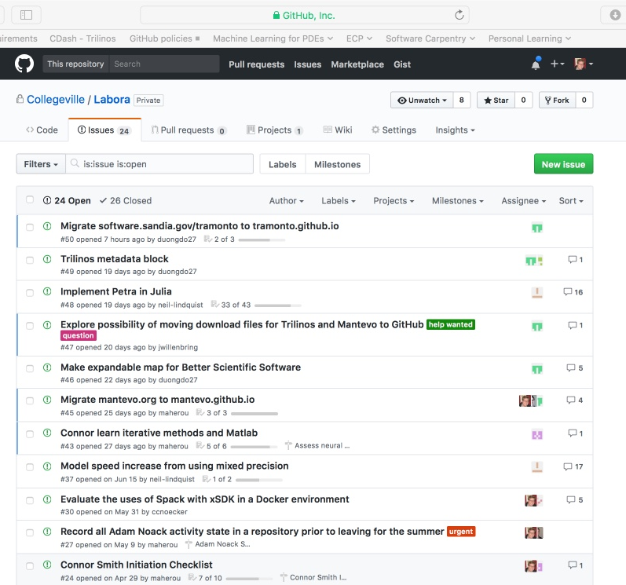
Step 3a: Create Issues
Select the Issues tab.
Click on New Issue.
Type in task statement 1 (from list).
Type in title only.
Click Submit new issue
Repeat.

Slide 33
Step 3b: Create Initiation Checklist
Select the Issues tab.
Click on New Issue.
Select team member, e.g., Pat Evans.
Type in title: Pat Evans Initiation Checklist
Add checklist items:
Use syntax (note the spaces): - [ ] Description

Slide 34
Step 4: Create Kanban Board
Select Projects tab
Click New Project
Use title
Team Kanban board
Add these columns:
Backlog, Ready, In progress, In review, Done.
Click on +Add cards (upper right).
Move each issue to the proper Kanban column

Slide 35
Wrap Up

Slide 36
Next Steps Summary:
Create a GitHub (or similar) Org and set of repos for your team:
Each team member has an individual repo.
Each project has a repo.
One special repo for issues.
Track all work:
Use checklists for initiation, exit, any big new effort.
Create Kanban board. Keep it current.
Aggregate related issues using milestones.
Drive meetings using Kanban board(s) – Can easily manage multiple.
Adapt this approach to meet your needs.
When you start to get sloppy, get back on track.

Slide 37
Other resources
The Agile Samurai: How Agile Masters Deliver Great Software (Pragmatic Programmers), Jonathan Rasmusson. Excellent, readable book on Agile methodologies. https://www.amazon.com/Agile-Samurai-Software-Pragmatic-Programmers/dp/1934356581 Also available on Audible.
Code Complete, Steve McConnell. Great text on software. Construx website has large collection of content.
https://www.scrumalliance.org - Portal to Scrum material
Kanban and Scrum -- Making the Most of Both, by Henrik Kniberg and Mattias Skarin – Easy-to-read intro to Kanban and Scrum.

Slide 38
Questions, comments?
Thank You.

